Slide 1
Window functions
Seminar 5

Slide 2
Analytical (window) functions
Analytical (window) functions:
Takes as an argument a column of the intermediate result of the calculation and return the same column.
The place of their use can only be the ORDER BY and SELECT sections that perform the final processing of the logical intermediate result.
Acts like aggregate functions, but do not reduce the level of detail.
Aggregate data in portions, the number and size of which is regulated by a special syntactic construction.

Slide 3
Syntax
function_name(expression) OVER (
[ <PARTITION BY clause> ] -- окно
[ <ORDER BY clause> ] -- сортировка
[ <ROWS or RANGE clause> ] -- границы окна
) AS attr_name

Slide 4

In a normal query, the entire set of rows is processed as a single "whole piece", for which aggregates are considered.
And when using window functions, the query is divided into parts (windows) and its aggregates are already considered for each of the individual parts
.

Slide 5
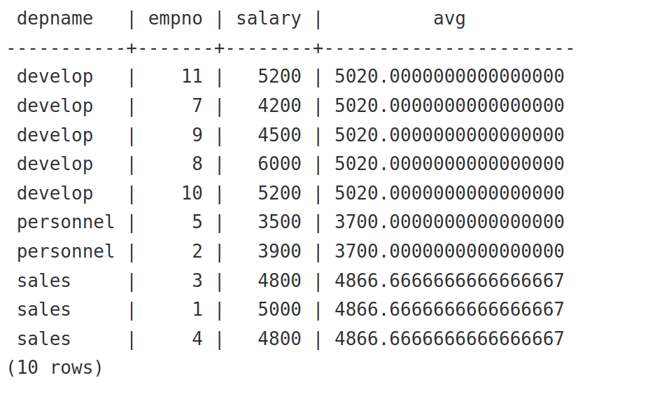
Example
An example showing how to compare the salary of each employee with the average salary of his department:
SELECT
depname,
empno,
salary,
avg(salary) OVER (PARTITION BY depname)
FROM
empsalary;

Slide 6
Example
The first three columns are extracted directly from the emp salary table, and there is a result row for each row of the table.
The fourth column turned out to be the average value calculated for all rows having the same depname value as the current row. (In fact, the average is calculated by the same ordinary, non-windowed avg function, but the OVER clause turns it into a windowed one, so that its action is limited to the window frames.)

Slide 7
OVER
OVER defines the set of rows that the window function will use, including data sorting. (“window”)
In the expression that specifies the window function, the OVER statement restricts the sets of rows with the same values in the field by which the division occurs.
The OVER() statement itself is unlimited and contains all the rows from the result set.
The OVER statement can be used multiple times in a single SELECT, each with its own division and sorting.

Slide 8
Partitioning rules
Inside OVER, you must specify the table field on which the “window” will slide and the rule by which the rows will be partitioned:
PARTITION BY: — responsible for partitioning criteria
Logically divides the set into groups according to criteria.
Analytical functions are applied to groups independently.
If you do not specify the partitioning construction, the entire set is considered one group.

Slide 9
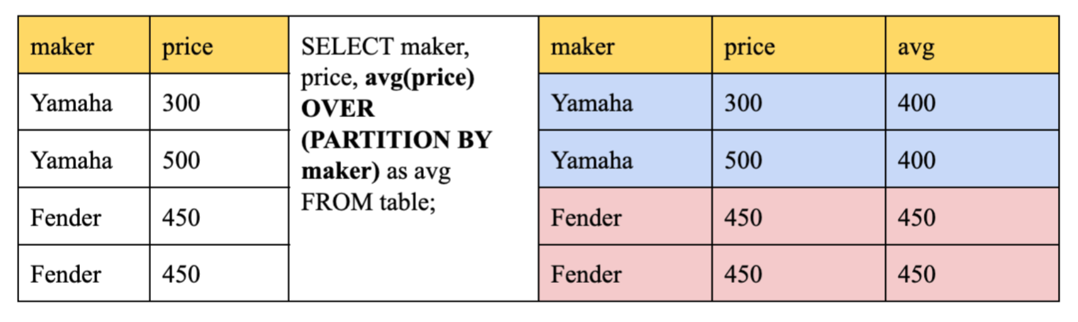

Slide 10
ORDER BY
ORDER BY: — responsible for sorting
Sets the sorting criteria within each group.
Aggregate functions in the absence of the ORDER BY construct are calculated for all rows of the group, and the same value is given for each row, i.e. the function is used as a summary.
If an aggregate function is used with an ORDER BY construct, then it is calculated on the current row and all rows before it, i.e. the function is used as a windowed one. (the cumulative total is calculated)

Slide 11
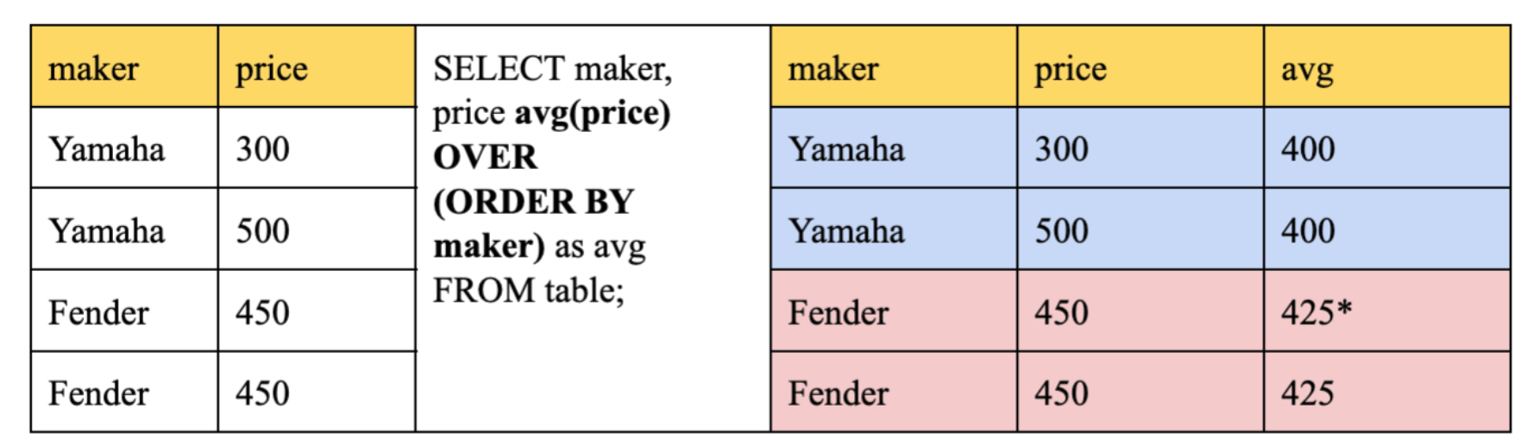

Slide 12
ROWS | RANGE
ROWS | RANGE: — additional restrictions on the range of window rows (the presence of ORDER BY is required):
ROWS (by rows) — allows you to manually determine the boundaries of the window for which the value is calculated; can work with PRECEDING/FOLLOWING.
RANGE (based on the values from ORDER BY, a sub-window is formed)— close enough to the previous one, but still not the same (Alexander Faritovich's professional opinion: “I have no idea when it can be used”); But using ‘RANGE CURRENT ROW’ after ORDER BY allows you to get rid of the cumulative total; does not know how to work with PRECEDING/FOLLOWING.
By default, it considers from UNBOUNDED PRECEDING to CURRENT ROW. (UNBOUNDED PRECEDING/FOLLOWING — we consider up to the end/beginning of the window.)
We select the lines within the window, but if necessary, we can manually register the previous/subsequent lines so that it can go beyond the window.

Slide 13
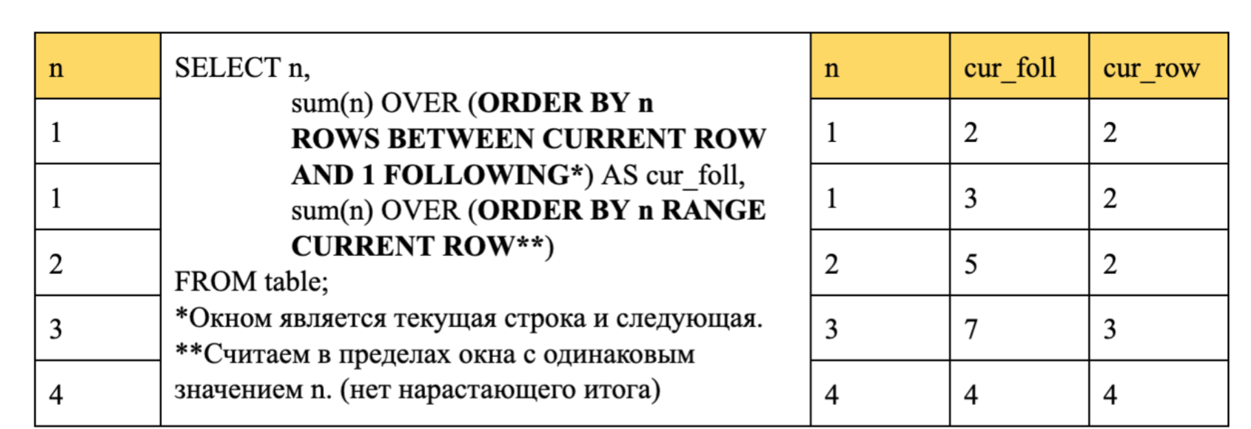
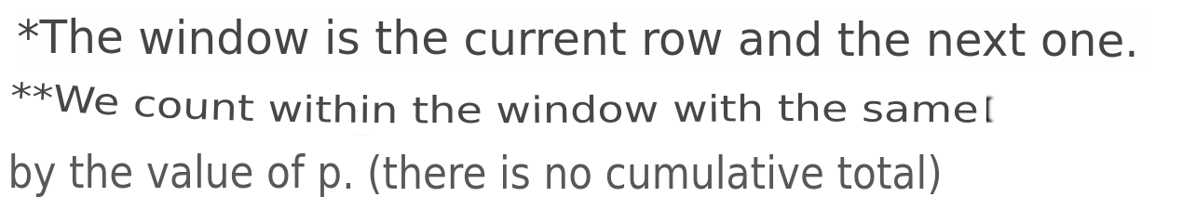

Slide 14
Classification of window functions
Aggregating (sum, avg, min, max, count)
Ranking (row_number, rank, dense_rank)
Offsets (lag, lead, first_value, last_value); offset functions are used with field indication.

Slide 15
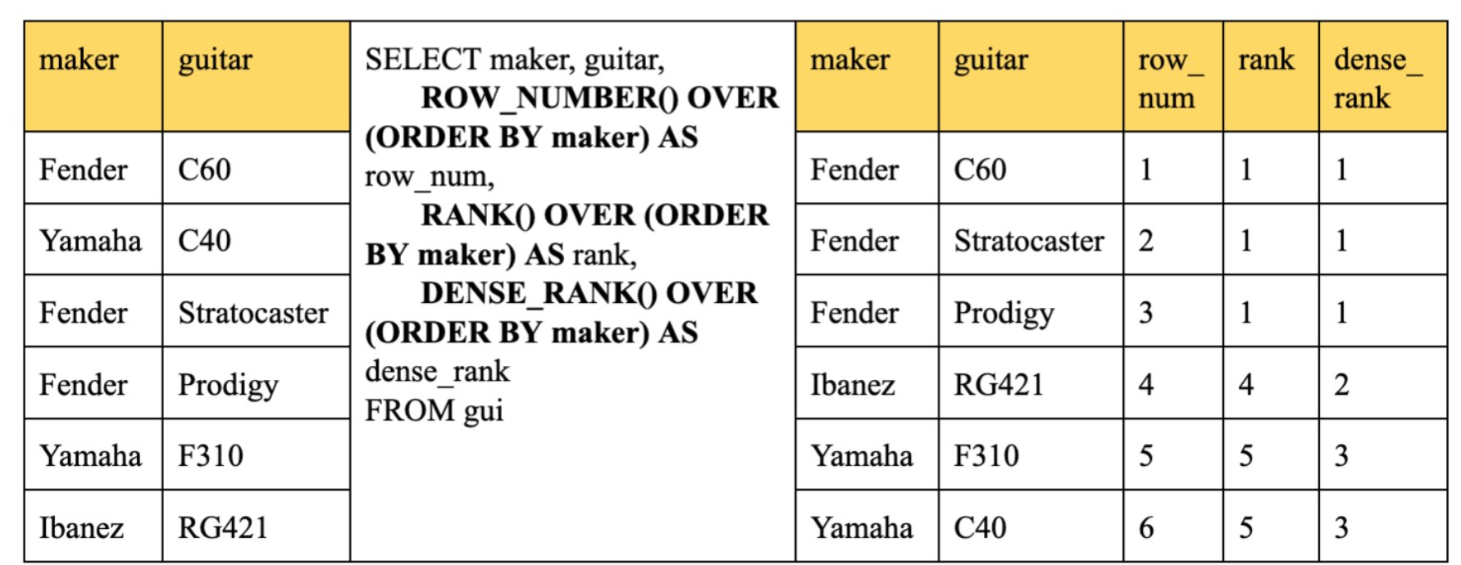
Ranking functions
row_number() – we number each row of the window sequentially with a step of 1.
rank() – rank each row of the window with a gap in the numbering when the values are equal.
dense_rank() – we rank each row of the window without breaks in the numbering when the values are equal.

Slide 16
Offset functions
lag(attr, offset (offset), default_value(default value in case our string is the first)) – the previous value with a shift.
lead(attr, offset, default_value) – the next value with a shift.
first_value(attr) – the first value in the window from the first to the current line.
last_value(attr) – the last value in the window from the first to the current line.

Slide 17
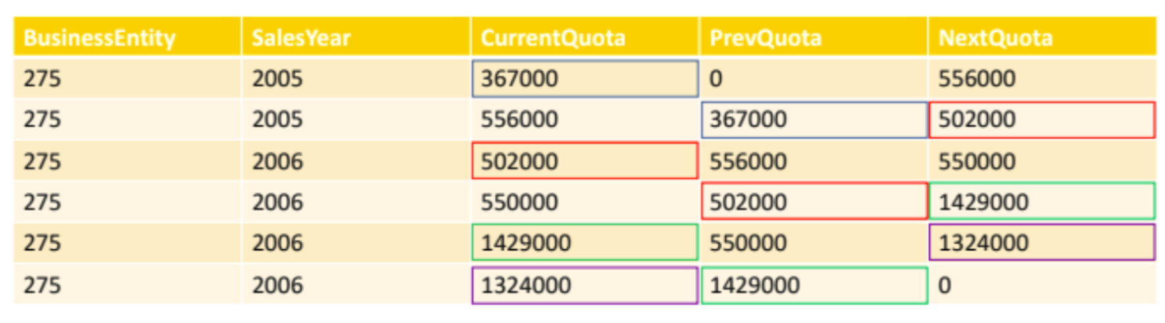
SELECT
BusinessEntity,
SalesYear,
CurrentQuota,
LAG(CurrentQuota, 1, 0) OVER (ORDER BY SalesYear) AS PrevQuota,
LEAD(CurrentQuota, 1, 0) OVER (ORDER BY SalesYear) AS NextQuota
FROM
SalesPersonQuotaHistory
WHERE
BusinessEntityID = 275;

Slide 18
Filtering
Filtering based on the results of calculating the window function
Window functions are allowed to be used in the request only in the SELECT list and the ORDER BY clause. In all other
offers, including GROUP BY, HAVING and WHERE, they are prohibited. This is explained by the fact that logically they are executed
after these sentences, as well as after non-window aggregate functions, and therefore the aggregate function can be called in
the arguments of the window, but not vice versa.

Slide 19
Example
If you need to filter or group rows after calculating window functions, you can use a nested query. For example:
SELECT
depname,
empno,
salary,
enroll_date
FROM (
SELECT
depname,
empno,
salary,
enroll_date,
rank() OVER (PARTITION BY depname ORDER BY salary DESC, empno) AS pos
FROM
empsalary
) AS ss
WHERE
pos < 3;

Slide 20
Named window function calls
When several window functions are calculated in a query for identically defined windows, of course, you can write
a separate OVER clause for each of them, but at the same time it will be duplicated, which will inevitably provoke errors.
Therefore, it is better to highlight the definition of a window in the WINDOW clause, and then refer to it in OVER. For example:

Slide 21
Example
SELECT
sum(salary) OVER w,
avg(salary) OVER w
FROM
empsalary
WINDOW
w AS (PARTITION BY depname ORDER BY salary DESC);

Slide 22
Useful links
SELECT
processing window functions
Window functions
Window functions

